Slide 1
RNN

Slide 2
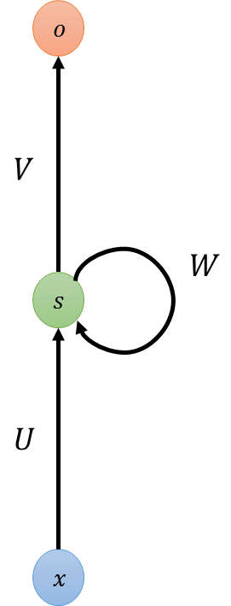

















Recurrent Neural Networks
Neural Networks
Inputs and outputs are independent
Recurrent Neural Networks
Sequential inputs and outputs
$$o$$
$$o$$
$$o$$
$$o_{t−1}$$
$$o_{t}$$
$$o_{t+1}$$
...
...
$$s$$
$$s$$
$$s$$
$$s$$
$$s$$
$$s$$
$$s$$
$$s$$
$$x$$
$$x$$
$$x$$
$$x_{t−1}$$
$$x_{t}$$
$$x_{t+1}$$

Slide 3
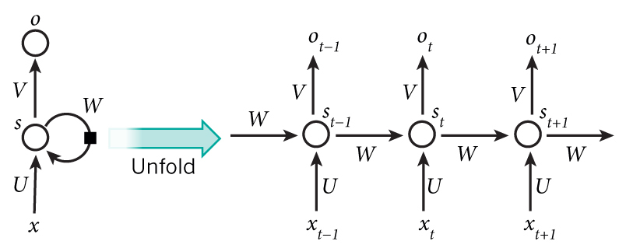
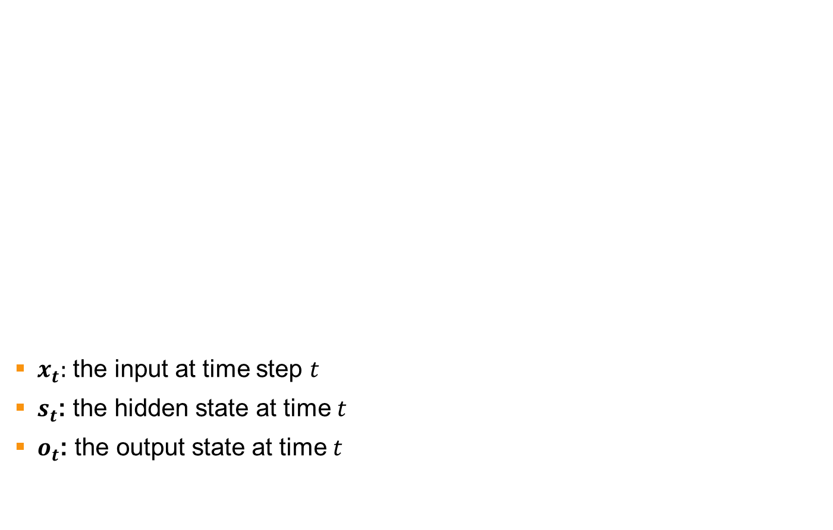
Recurrent Neural Networks (RNN)
$x_{t}:$ the input at time step $t$
$s_{t}$: the hidden state at time $t$
$o_{t}$: the output state at time $t$
Image from WILDML.com: “RECURRENT NEURAL NETWORKS TUTORIAL, PART 1 – INTRODUCTION TO RNNS”

Slide 4
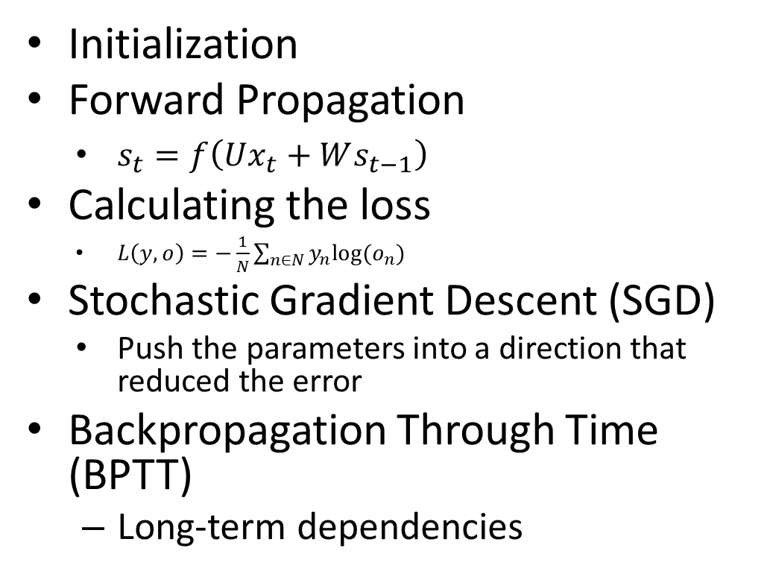
Recurrent Neural Networks (RNN)
Initialization
Forward Propagation
$s_{t}=f\left(Ux_{t}+Ws_{t−1}\right)$
Calculating the loss
$L\left(y,o\right)=−\frac{1}{N}\sum_{n∈N}{y_{n}log⁡(o_{n})}$
Stochastic Gradient Descent (SGD)
Push the parameters into a direction that reduced the error
Backpropagation Through Time (BPTT)
Long-term dependencies
Back
propagation
Backpropagation
Through Time (BPTT)

Slide 5
Vanishing gradient over time
Standard RNN with sigmoid
The sensitivity of the input values decays over time
The network forgets the previous inpu
Long-Short Term Memory (LSTM) ^{[2]}
The cell remember the input as long as it wants
The output can be used anytime it wants

Slide 6

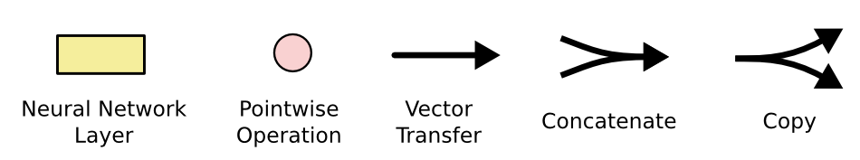
Long Short-Term Memory (LSTM)
Ability to choose what to forget and what to memorize

Slide 7
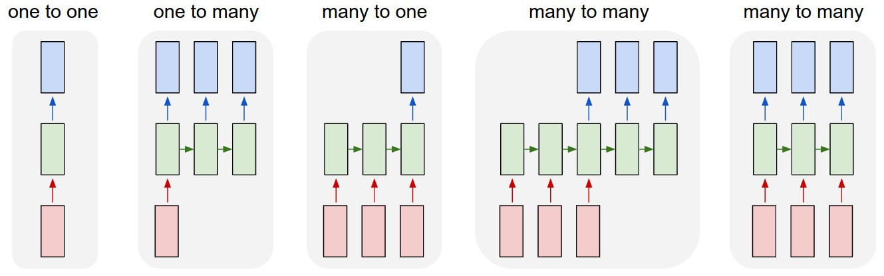
Design Patterns for RNN
RNN Sequences
Task | Input | Output
Image classification | fixed-sized image | fixed-sized class
Image captioning | image input | sentence of words
Sentiment analysis | sentence | positive or negative sentiment
Machine translation | sentence in English | sentence in French
Video classification | video sequence | label each frame
Blog post by A. Karpathy. “The Unreasonable Effectiveness of Recurrent Neural Networks” (2015)

Slide 8
Hyper-parameter Tuning

Slide 9
Motivation
Machine Learning is extremely powerful.
Tuning ML systems is extremely non-intuitive.
“…we still don’t really know why some configurations of deep neural networks work in some cases and not others, let alone having a more or less automatic approach to determining the architectures and the parameters. “
Xavier Amatriain, Director of Research at Quora

Slide 10
Tuning Machine Learning Models
Big Data
New Parameters
Optimization
Predictive Models
Better Models
Objective Metric

Slide 11
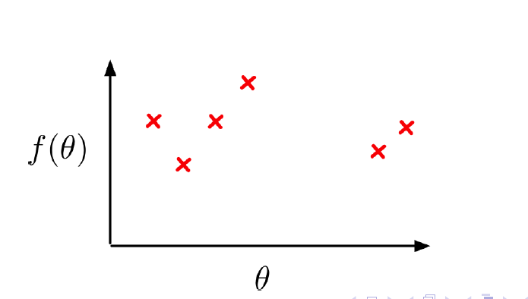
Bayesian Global Optimization
Optimize object function
Loss, Accuracy, Likelihood
Given parameters
Hyper-parameters, feature parameters
Find the best hyper-parameters
Sample function as few times as possible
Training on big data is expensive

Slide 12
How Does It Work?
1. Build Gaussian Process (GP) with points sampled so far
2. Optimize the fit of the GP (covariance hyper-parameters)
3. Find the point(s) of the highest Expected Improvement within parameter domain
4. Return optimal next best point(s) to sample

Slide 13
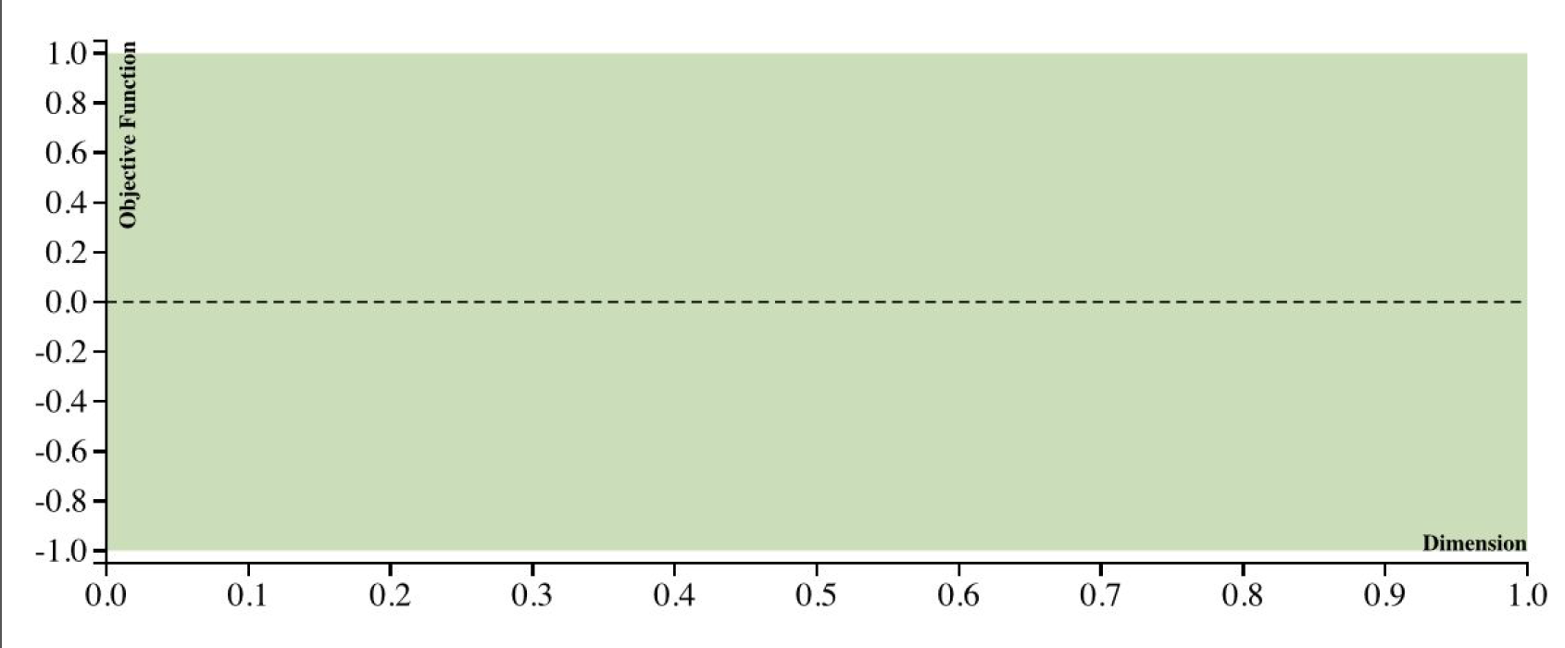
Gaussian Process

Slide 14
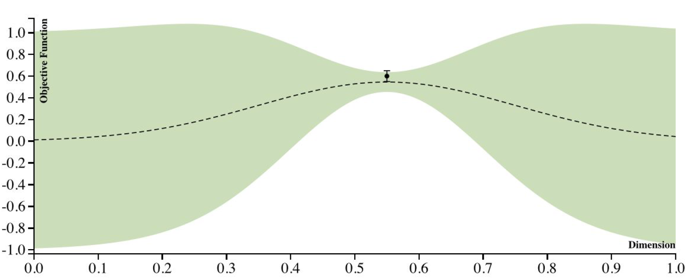
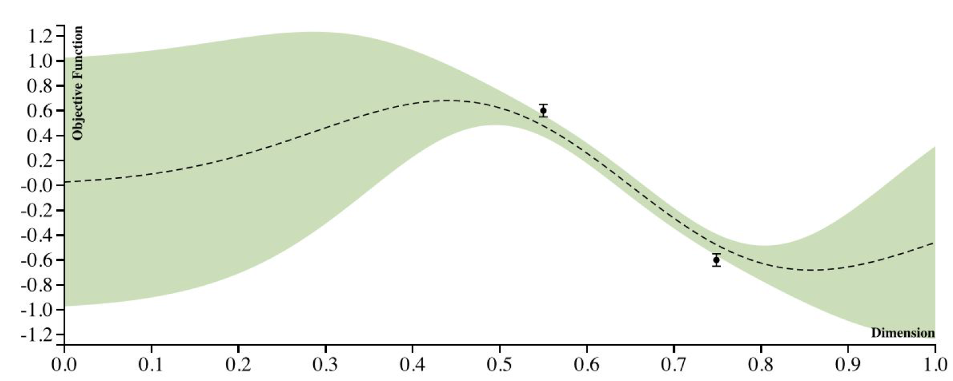
Gaussian Process

Slide 15
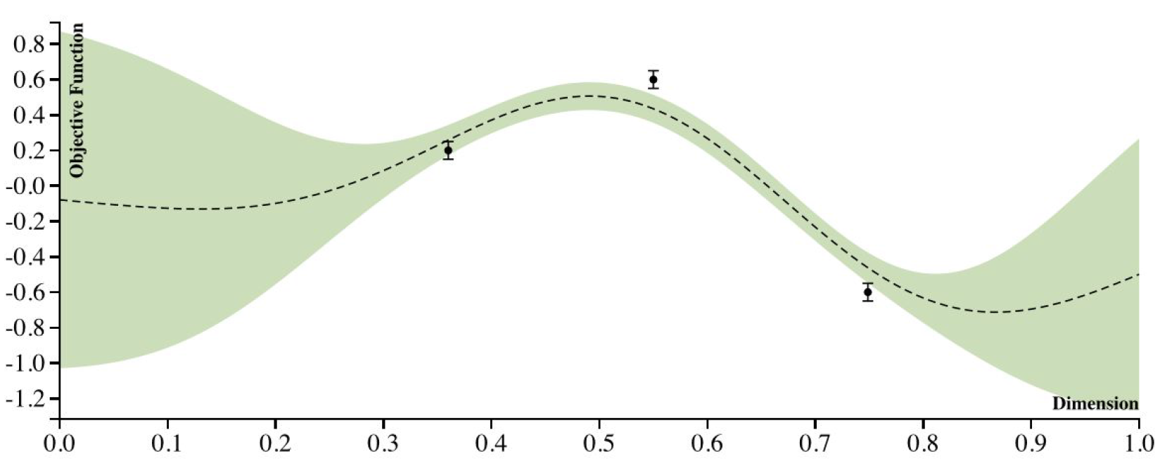
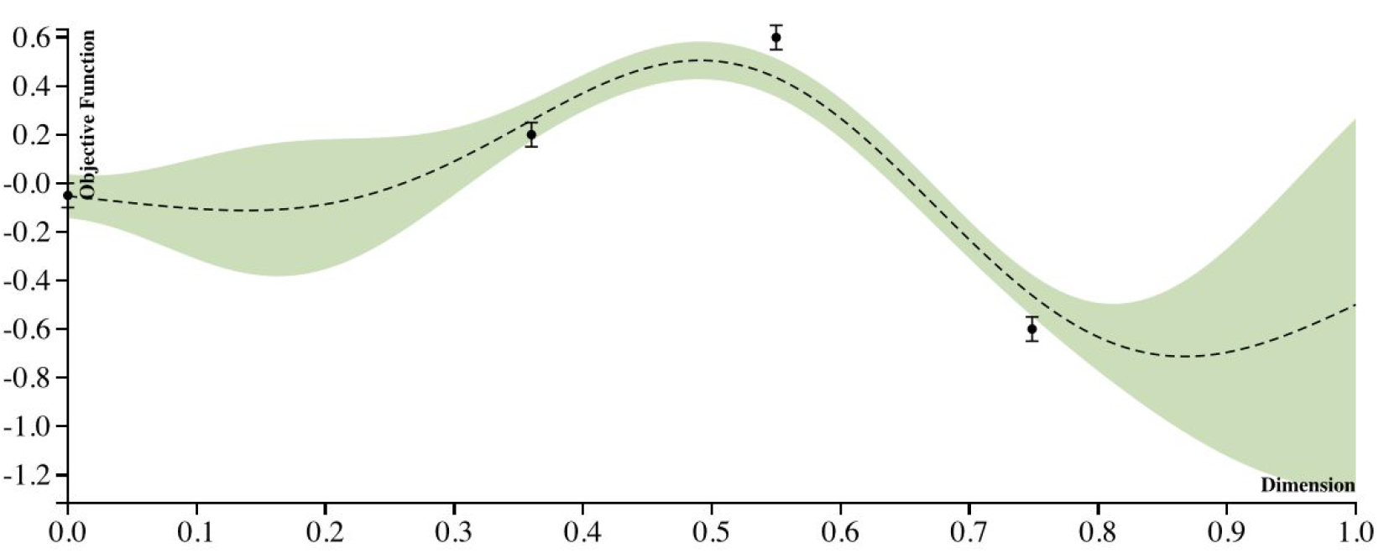
Gaussian Process

Slide 16
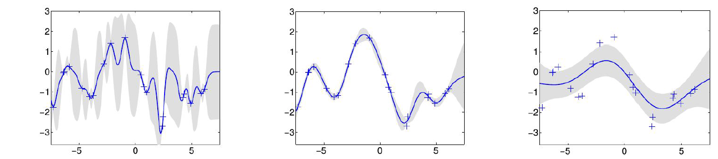
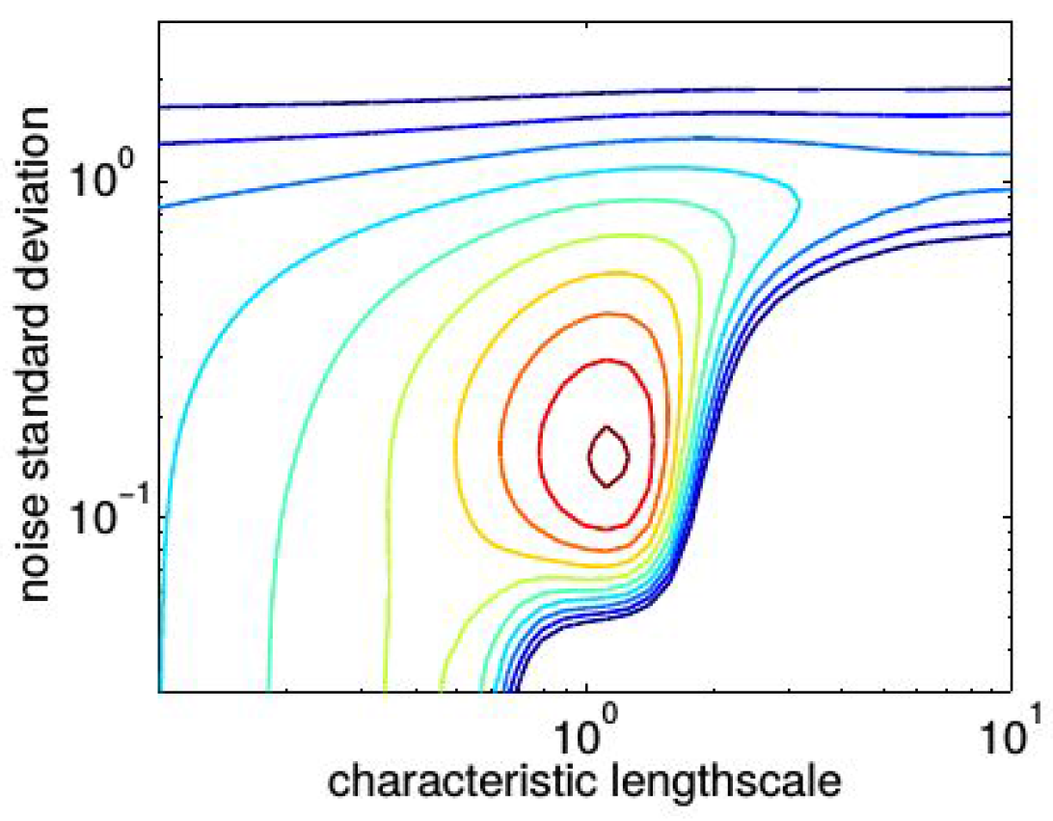
Gaussian Process
overfit
Good fit
underfit

Slide 17
Bayesian Optimization Summary
Fast
Quickly optimize objective function
Customizable
Parameters, iterations
More confident in tuning
Integrated into our framework

